Slide 1
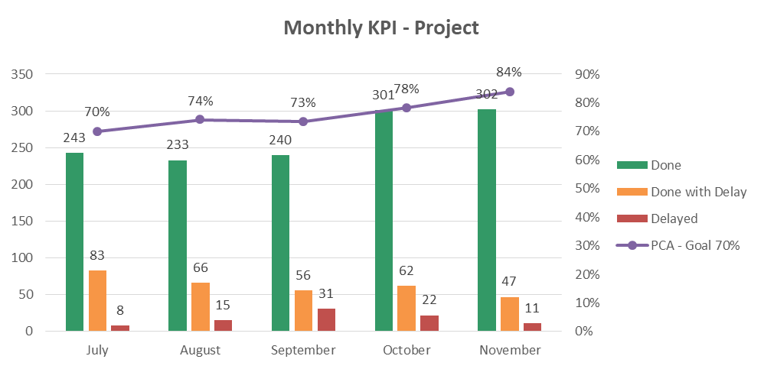
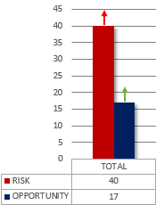
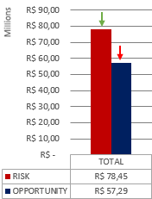
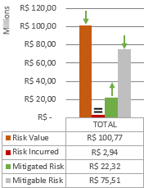
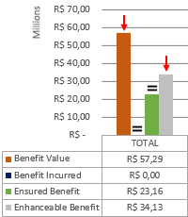
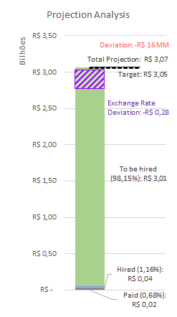
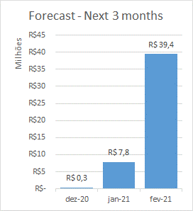
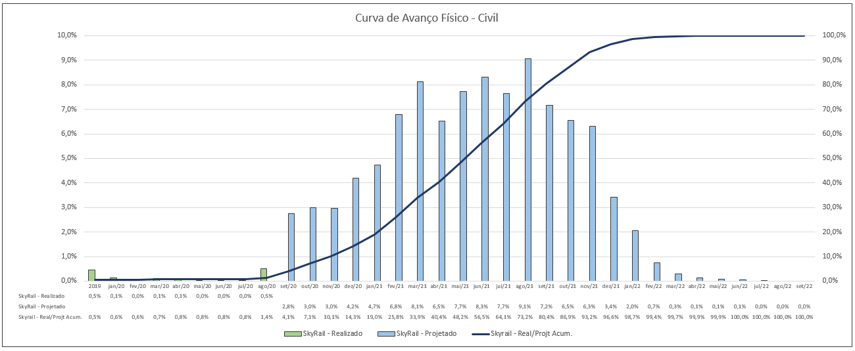
PROJECT
CIVIL
SYSTEMS
ROLLING STOCK
MONTHLY ACTION PLAN
RISK & OPPORTUNITY – Data base November/2020
QUANTITY
VALUE
RISK VALUE STATUS
OPPORTUNITY VALUE STATUS
FINANCIAL ANALYSIS – Data base November/2020
FINANCIAL ANALYSIS
% do mês
% prev do mês
% acum.
% prev acum

Slide 2
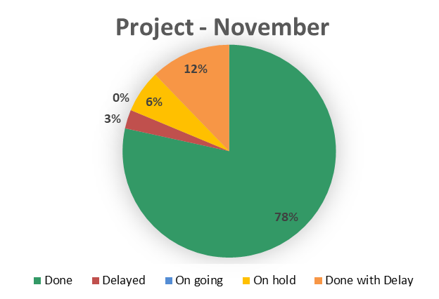
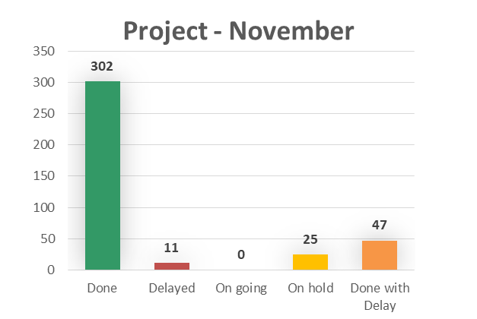
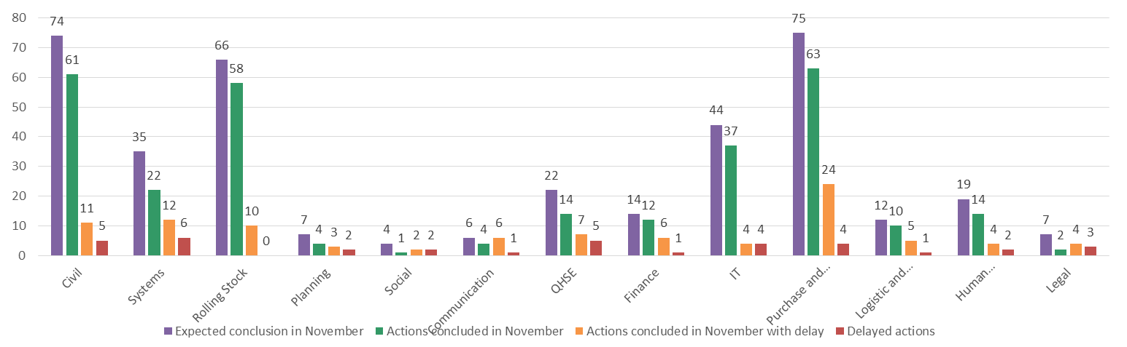
PROJECT
CIVIL
SYSTEMS
ROLLING STOCK
MONTHLY ACTION PLAN
STATUS OF ACTIONS BY DEPARTMENT

Slide 3
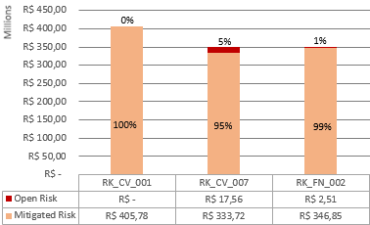
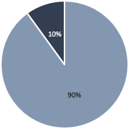
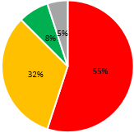
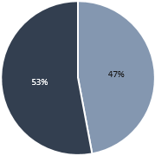
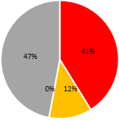
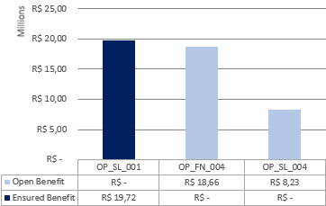



PROJECT
CIVIL
SYSTEMS
ROLLING STOCK
3 MAIN RISKS
RISK & OPPORTUNITY – Data base November/2020
QUANTITY
VALUE
RISK VALUE STATUS
OPPORTUNITY VALUE STATUS
RK_CV_001 – FAILURE TO ACHIEVE ECONOMIC REBALANCING DUE TO DELAY IN LICENSES/AUTHORIZATIONS
RK_CV_007 - DELAY IN IPHAN’S LICENSE AND AUTHORIZATIONS
RK_FN_002 - EXCHANGE RATE LOSS COMPARED TO THE BUDGET RATE
RISK
STATUS
OPPORTUNITY
STATUS
3 MAIN OPPORTUNITIES
MAIN COMMENTS
Balance: possible loss of R$ 29,45 millions, an improvement of R$ 20 millions, or 41%.
Risk quantity: 9 new risk, increase of 29%.
Risk value: R$ 34 millions decrease representing 30%
Opportunity quantity: 4 new, increase of 31%
Opportunity value: R$ 5 millions decrease, representing 8,5%
OP_SL_001 – EX-TARIFF FOR SIGNALING SYSTEM
OP_FN_004 – COST CONTROL PROCEDURE TO ACHIEVE THE TARGET
OP_SL_004 – EX-TARIFF FOR 3º & 4º RAIL

Slide 4
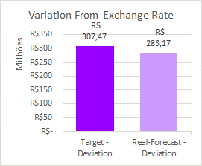
PROJECT
CIVIL
SYSTEMS
ROLLING STOCK
FINANCIAL ANALYSIS – Data Base November/2020*
Main Payments – Next 3 months
December/2020
January/2021
February/2021
(License) Calçada to Acesso Norte Construction License – R$ 114 K
(License) Construction Licenses / RAIPA/PAIPA / Traffic Impact Study – R$ 91 K
(Studies and Designs) BMA / Rajendra – R$ 85 K
(EPC Company) Downpayment EPC Preliminar Contract – R$ 6,60 MM
(System - Design) Downpayment Sener Detailed Design – R$ 761 K
(Expropriation) 1st payment of IDEIAS studies adequation – R$ 125 K
(Curve Beaming Tooling) Delivery of 5 sets from NINIVE – R$ 16,09 MM
(EPC Company) PowerChina Preliminar Works – R$ 9,88 MM
(Catwalk) Contract Downpayment – R$ 8,00 MM
Main Hiring Contracts – Next 3 months
Main Deviations
Contract
Value
Month
Main Projected Deviations**
Train
Systems Div 21
Systems Div 23
Track Switch
Depot Equip + MIV
R$ 960,8 MM
R$ 216,2 MM
R$ 336,5 MM
R$ 103,1 MM
R$ 20,8 MM
January/21
January/21
January/21
January/21
January/21
Contract
Value
%
Expropriation
Integration
Curve Beaming Tooling
Design
- R$ 25,98 MM
- R$ 18,00 MM
-R$ 1,28 MM
R$ 2,30 MM
-77,36%
-
-3,54%
16,63%
Variation between projections with dollar quotation R$ 5,09 and projections with the Budget dollar quotation R$ 4,07.
P.S.: Ninive contract projected with Euro quotation R$ 6,19.
** Comparing to Target

Slide 5
PROJECT
CIVIL
SYSTEMS
ROLLING STOCK
Principais atividades em atraso, principais pontos de atenção e planos de recuperação.
FINANCIAL ANALYZES
% do mês
% prev do mês
% acum.
% prev acum

Slide 6
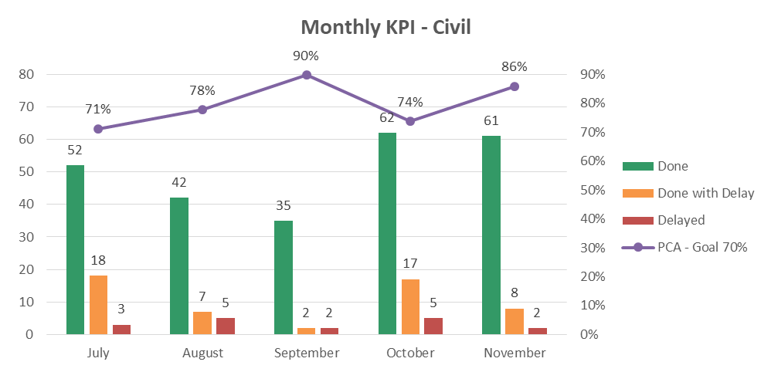
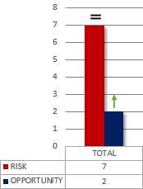
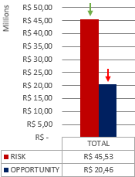
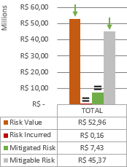
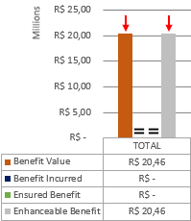
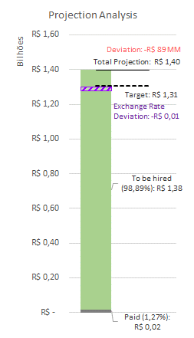
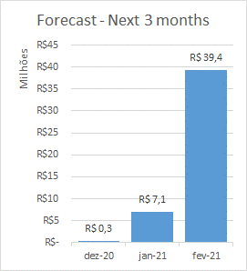
PROJECT
CIVIL
SYSTEMS
ROLLING STOCK
MONTHLY ACTION PLAN
RISK & OPPORTUNITY
QUANTITY
VALUE
RISK VALUE STATUS
OPPORTUNITY VALUE STATUS
FINANCIAL ANALYSIS – Data base November/2020
FINANCIAL ANALYZES
% do mês
% prev do mês
% acum.
% prev acum

Slide 7
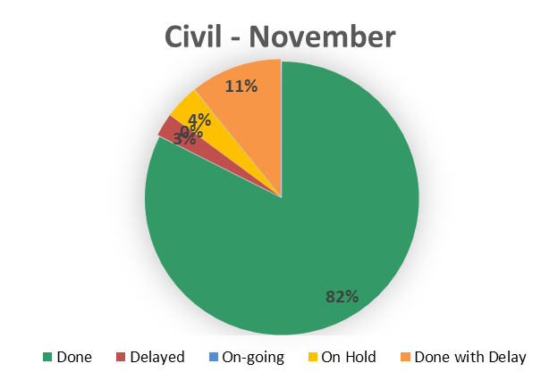
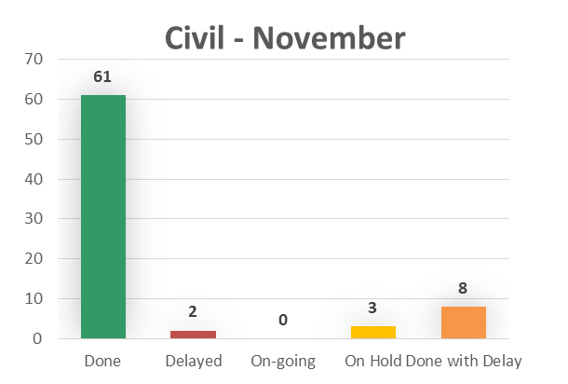
PROJECT
CIVIL
SYSTEMS
ROLLING STOCK
MONTHLY ACTION PLAN
ACTIONS DELAYED / ON-HOLD
Action | Department | Finish | Postponed Date | Status
RDM about accessibility of the stations | Civil | 16-out-20 |  | On Hold
Request DAM Payment about Construction License in S. Joaquim - Comércio | Civil | 16-nov-20 |  | On Hold
RDM for changing the position Acesso Norte's track switch | Civil | 30-jul-20 | 23-out-20 | On Hold

Slide 8
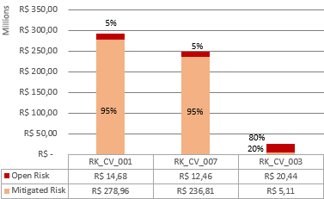
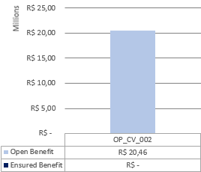
PROJECT
CIVIL
SYSTEMS
ROLLING STOCK
3 MAIN RISKS
RISK & OPPORTUNITY
QUANTITY
VALUE
RISK VALUE STATUS
OPPORTUNITY VALUE STATUS
RK_CV_001 - DELAY IN LICENSES AND AUTHORIZATIONS
RK_CV_007 - DELAY IN LICENSES AND AUTHORIZATIONS FROM IPHAN
RK_CV_003 - EXPROPRIATION EXTRA VALUE, DUE TO PS5 FROM IFC
MAIN COMMENTS
3 MAIN OPPORTUNITIES
Risk quantity: the same of september.
Risk value: decrease of 27%
Opportunity value: 59% decrease
Opportunity quantity: 1 new, possibility of earn a discount reducing the Catwalk scope
OP_CV_002 – EARN A DISCOUNT ON CATWALK CONTRACT BY REDUCING THE SCOPE

Slide 9
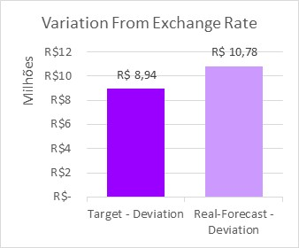
PROJECT
CIVIL
SYSTEMS
ROLLING STOCK
FINANCIAL ANALYSIS – Data Base November/2020*
Main Payments – Next 3 months
October/2020
November/2020
December/2020
(Curve Beaming Tooling) Conceptual Design – R$ 6,03 MM
(Expropriation) Downpayment IDEIAS Contract – R$ 475 K
(Camp Site) WG Contract / Air Conditioner / Furnitures – R$ 191 K
(Camp Site) WG Contract / Mega Realty / Furnitures – R$ 259 K
(License) Calçada to Acesso Norte Construction License – R$ 114 K
(License) Lentz Contract – R$ 94 K
(EPC Company) Downpayment EPC Preliminar Contract – R$ 6,77 MM
(Camp Site) WG Contract / Mega Realty / Furnitures – R$ 94 K
(License) Construction Licenses – R$ 71 K
Main Hiring Contracts – Next 3 months
Main Deviations
Contract
Value
Month
Main Projected Deviations**
Contract
Value
%
IDEIA
EPC Preliminar Contract
R$ 44,0 K
R$ 66,0 MM
October/20
November/20
EPC Company
Expropriation
Catwalk
- R$ 114,01 MM
- R$ 89,95 MM
- R$ 23,24 MM
- 10,90%
- 272,23%
- 46,49%
Main Deviations comparing to last month
Contract
August/20
September/20
Variation between projections with dollar quotation R$ 5,38 and projections with the Budget dollar quotation R$ 4,07.
P.S.: Ninive contract projected with Euro quotation R$ 6,37.
Expropriation
- R$ 75,57 MM
- R$ 89,95 MM
** Comparing to Target

Slide 10
PROJECT
CIVIL
SYSTEMS
ROLLING STOCK
Principais atividades em atraso, principais pontos de atenção e planos de recuperação.
FINANCIAL ANALYZES
% do mês
% prev do mês
% acum.
% prev acum

Slide 11
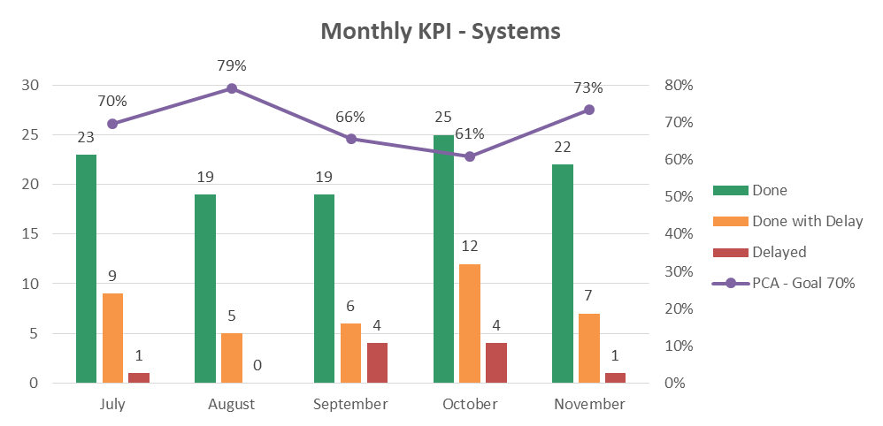
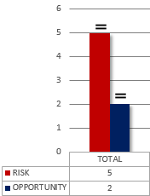
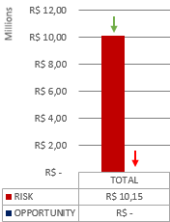
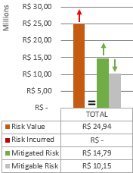
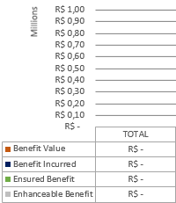
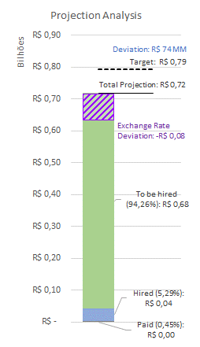
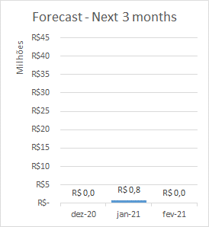
PROJECT
CIVIL
SYSTEMS
ROLLING STOCK
MONTHLY ACTION PLAN
RISK & OPPORTUNITY
QUANTITY
VALUE
RISK VALUE STATUS
OPPORTUNITY VALUE STATUS
FINANCIAL ANALYSIS – Data base November/2020
FINANCIAL ANALYZES
% do mês
% prev do mês
% acum.
% prev acum

Slide 12
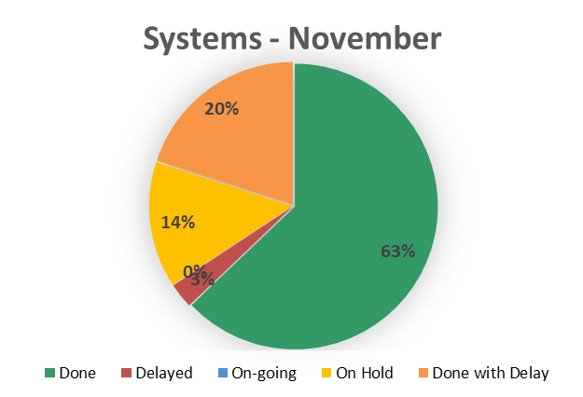
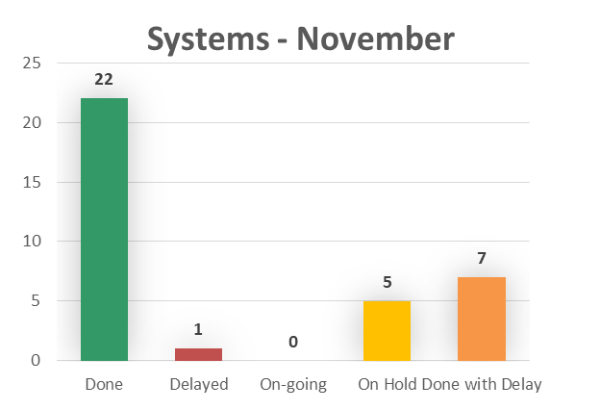
PROJECT
CIVIL
SYSTEMS
ROLLING STOCK
MONTHLY ACTION PLAN
ACTIONS DELAYED / ON-HOLD
Action | Department | Finish | Postponed Date | Status
Line distribuition and União-2 SE basic project Hired definition | Systems | 21-out-20 | 30-out-20 | On Hold
Analysis of the Conductive rail contract |  | 6-nov-20 | 30-nov-20 | On Hold
Analysis of the PSD System contract | Systems | 16-nov-20 | 30-nov-20 | On Hold
Analysis of 05 detail design documents sent to SENER (Com & Sign) to refering to package of the 0016 e 0018 documents sent by SENER | Systems | 19-nov-20 | 4-dez-20 | On Hold
Analysis of 02 detail design documents sent to SENER (PSD) to refering to package of the 0020 documents sent by SENER. | Systems | 20-nov-20 | 7-dez-20 | Delayed

Slide 13
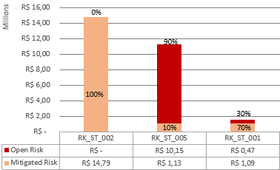
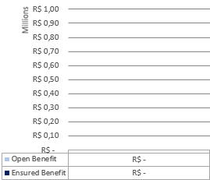
PROJECT
CIVIL
SYSTEMS
ROLLING STOCK
3 MAIN RISKS
RISK & OPPORTUNITY
QUANTITY
VALUE
RISK VALUE STATUS
OPPORTUNITY VALUE STATUS
RK_ST_002 - NOT APPROVAL OF LTE-U TECHNOLOGY BY CTB & ANATEL
RK_ST_005 - MISCALCULATED CAPEX OF CABLE TRAYS
RK_ST_001 – DELAY DEFINITION OF POWER SUPPLY FINAL SUPPLIER
MAIN COMMENTS
3 MAIN OPPORTUNITIES
Risk quantity: the same of september.
Risk value: 35% decrase
Mitigated risk: 1 representing avoinding na extra expense of R$ 14.790.392,48
Opportunity value: 100% decrease,
Opportunity quantity: the same of september
NO OPPORTUNITY THIS MONTH

Slide 14
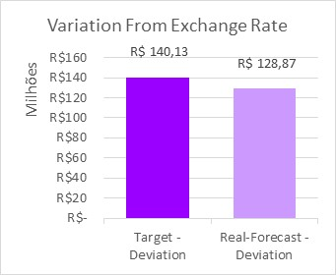
PROJECT
CIVIL
SYSTEMS
ROLLING STOCK
FINANCIAL ANALYSIS – Data Base November/2020*
Main Payments – Next 3 months
October/2020
November/2020
December/2020
(Design) Taxes – R$ 7,8 K
No System Payment
No System Payment
Main Hiring Contracts – Next 3 months
Main Hiring Contracts – Next 3 months
Main Deviations
Contract
Value
Month
Main Projected Deviations**
Sener
Signaling
Track Switch
Telecom
Power Supply
3rd and 4th Rails
PSD
R$ 8,1 MM
R$ 211,5 MM
R$ 95,1 MM
R$ 91,0 MM
R$ 89,0 MM
R$ 84,7 MM
R$ 39,6 MM
October/20
December/20
December/20
December/20
December/20
December/20
December/20
Contract
Value
%
Integration
Track Switch
PSD
AFC
- R$ 18,0 MM
R$ 12,24 MM
R$ 8,46 MM
R$ 2,19 MM
-
11,41 %
14,51%
8,70%
Main Deviations comparing to last month
Contract
August/20
September/20
Variation between projections with dollar quotation R$ 5,38 and projections with the Budget dollar quotation R$ 4,07.
Track Switch
PSD
AFC
-
-
-
R$ 12,24 MM
R$ 8,46 MM
R$ 2,19 MM
** Comparing to Target

Slide 15
PROJECT
CIVIL
SYSTEMS
ROLLING STOCK
Principais atividades em atraso, principais pontos de atenção e planos de recuperação.
FINANCIAL ANALYZES
% do mês
% prev do mês
% acum.
% prev acum

Slide 16
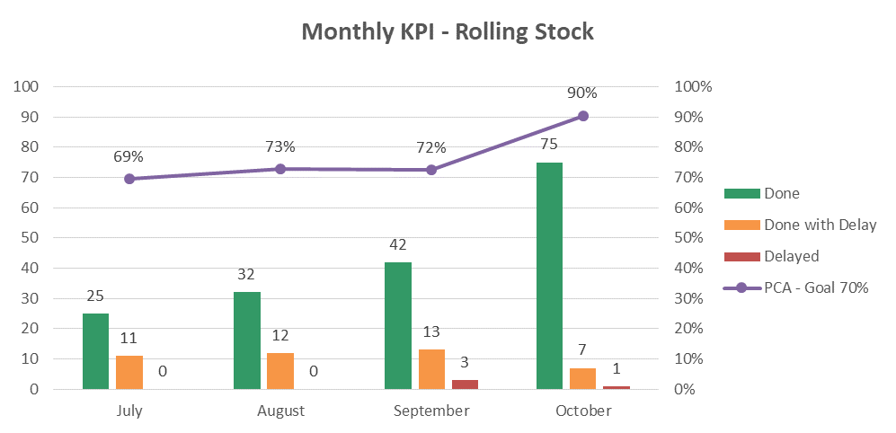
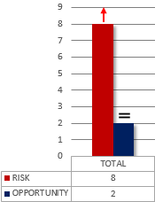
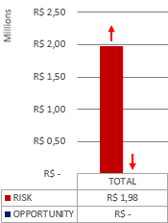
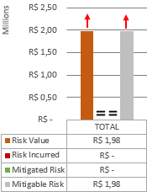
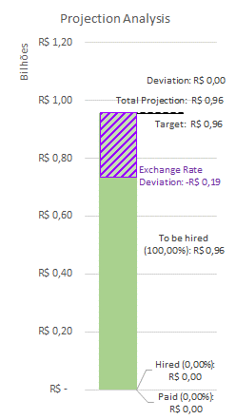
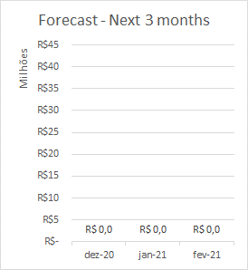
PROJECT
CIVIL
SYSTEMS
ROLLING STOCK
MONTHLY ACTION PLAN
RISK & OPPORTUNITY
QUANTITY
VALUE
RISK VALUE STATUS
OPPORTUNITY VALUE STATUS
FINANCIAL ANALYSIS – Data base November/2020
FINANCIAL ANALYZES
% do mês
% prev do mês
% acum.
% prev acum

Slide 17
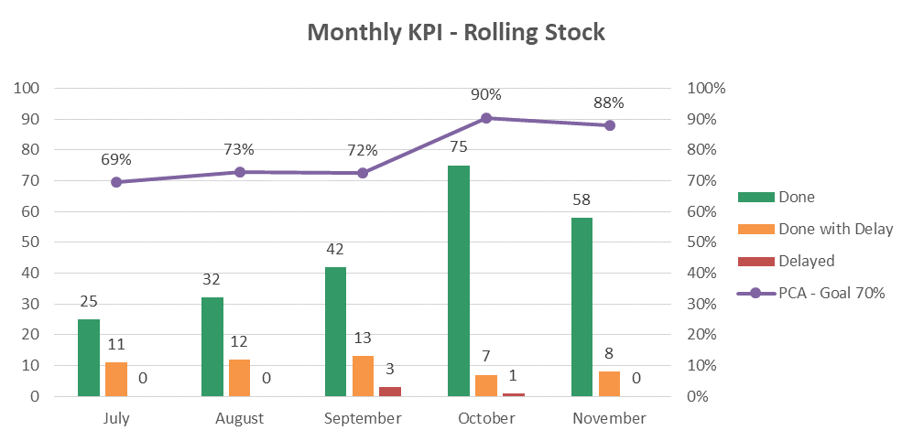
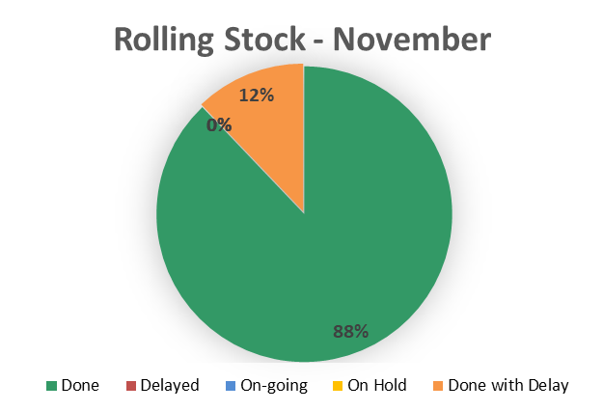

PROJECT
CIVIL
SYSTEMS
ROLLING STOCK
MONTHLY ACTION PLAN
ACTIONS DELAYED / ON-HOLD
Action | Department | Finish | Postponed Date | Status
Revision of Operational Plan | Rolling Stock | 23-set-20 |  | On Hold

Slide 18

PROJECT
CIVIL
SYSTEMS
ROLLING STOCK
3 MAIN RISKS
RISK & OPPORTUNITY
QUANTITY
VALUE
RISK VALUE STATUS
OPPORTUNITY VALUE STATUS
RK_RS_007 – MIV CAPEX DO NOT COMPLY WITH MARKET PRICE
RK_RS_001 – DELAY IN THE TRACK SWITCH CONTRACT
RK_RS_004 – DELAY IN PROJECT DUE NON-ACCEPTANCE OF THE TRAIN
MAIN COMMENTS
3 MAIN OPPORTUNITIES
Risk quantity: 2 new.
Risk closed: 1 closed.
Risk value: 40% increase
Opportunity value: 100% decrease
Opportunity quantity: the same of september.
NO OPPORTUNITY THIS MONTH

Slide 19

PROJECT
CIVIL
SYSTEMS
ROLLING STOCK
FINANCIAL ANALYSIS – Data Base November/2020*
Main Payments – Next 3 months
October/2020
November/2020
December/2020
No Rolling Stock Payments
No Rolling Stock Payments
No Rolling Stock Payments
Main Hiring Contracts – Next 3 months
Main Hiring Contracts – Next 3 months
Main Deviations
Contract
Value
Month
Main Projected Deviations***
Contract
Value
%
Train
Track Switch**
Depot Equipments**
Maintenance Vehicle**
R$ 1.009,5 MM
R$ 95,1 MM
R$ 11,8 MM
R$ 9,0 MM
December/20
December/20
December/20
December/20
Train
Track Switch**
-
R$ 12,24 MM
-
11,41 %
Main Deviations comparing to last month
Contract
August/20
September/20
Variation between projections with dollar quotation R$ 5,38 and projections with the Budget dollar quotation R$ 4,07.
Track Switch**
-
R$ 12,24 MM
** Items included in the Systems Budget, but managed by Rolling Stock Team
*** Comparing to Target

Slide 20
PROJECT
CIVIL
SYSTEMS
ROLLING STOCK
Principais atividades em atraso, principais pontos de atenção e planos de recuperação.
FINANCIAL ANALYZES
% do mês
% prev do mês
% acum.
% prev acum

Slide 21


THANK YOU
Metrogreen Skyrail Concessionária da Bahia S.A.

